Slide 1

Improving CRA Contact Us
A Collaborative Optimization Project Results and recommendations comparing baseline and validation task performance by Canadian small business owner participants
March 2019

Slide 2
Contents
Task performance measurement test results comparing baseline & validation
Part 1 Results and recommendations - improvements, success rates & potential outcomes
Part 2: Appendix Detailed analysis by task
Use the prototype as it existed for this Validation testing: https://gc-proto.github.io/cra-contactus/ut-en-validation.html
Updated prototype for implementation and discussion: https://gc-proto.github.io/cra-contactus/ut-en-prototype.html
This project also included experimentation with:
Redesign for Canada.ca of the Institutional Profile design - covered here
Find a mailing address web app based on a simplified tax centre alignment
Presentation provided to PAB for Services Branch discussion
Voice single and multi-turn and chatbot solutions for Contacts
Voice and Chat Summary in this deck
Voice Results and analysis presentation

Slide 3

Fewer people call/mail, and those that do, get the right number/address
Goals | Target | User outcomes
The right CRA contact information is easy to find through Canada.ca. | A 20% increase in average task findability, or findability rate of 80%. | Canadians spend less time looking for the right contact information on Canada.ca
CRA contact information is easy to use. | A 20% increase in average task completion, or task completion rate of 80%. | Canadians will get answers quickly via voice, phone or computer for the right contacts to call, mail, or email for a particular problem
Notes:
.

Slide 4
Optimization for top Canada.ca tasks
Discovery
Baseline Test
Design/
prototyping
Validation Test
Optimized?
Launch
1
2
3
4
Engage collaborative team for discovery.
Identify task scenarios to fix
Measure task scenario performance of current content with Canadians
Develop prototype to fix content - test during design
Measure task scenario performance on the team’s prototype
Did prototype task success rates meet target?
As determined by participating department(s)
Notes:
Baseline testing done by NeoInsite spring 2018

Slide 5
Tests reflect call centre input and analytics evidence
Collaborative team used call centre data & analytics to characterize top issues
Fleshed out issues with examples from call centre team
Crafted and refined stories into set of task scenarios with clear answers
270,000 calls per year to change direct deposit
When i moved my mortage to a new bank, I need to get CRA to put my tax refund into the new bank account so I can pay it on time.
Task 2 Direct deposit - call ITE line
You renewed your mortgage, and you moved all your bank accounts to a new bank. What number would you call to get your personal tax refund into your new bank account?

Slide 6
Task scenarios covered full range of outcomes
Desired Outcome | Task scenario | Starting point
Reduce calls - use automated line | T1 Proof on Sunday -TIPS | Google in Baseline, CRA profile in Validation
Reduce calls - use automated line | T5 Monday - Telerefund | CRA institutional profile
Reduce calls - find My Account | T103 NOA via My Account | Contact
Reduce calls - find Antifraud | T8 Scam - Antifraud | CRA institutional profile
Reduce redirects to Benefits | T4 Child Benefits -Benefits | Canada.ca home
Reduce redirects from Business | T6 Misallocated payment - ITE | CRA institutional profile
Reduce redirects from Business | T7 Corporate -Payment arrangements | CRA institutional profile
Reduce calls for address & mail redirects | T9 Address T2062 -Surrey King George | PDF T2062 form
Reduce calls for address & mail redirects | T10 Address RC1 - PEI Pope Road | PDF RC1 form
Reduce calls for address & mail redirects & searches | T15 Address T1 - Sudbury | Canada.ca home
Reduce calls for address (Validation only) | T16 Address e410 - Calgary | CRA institutional profile
Find correct number for direct deposit | T2 Direct Deposit - ITE | CRA institutional profile
Find correct number for NOA | T3 Notice of Assessment NOA -ITE | Canada.ca home
Find correct number (Validation only) | T17 Corporation internet help desk | CRA iContact page
Find correct number for security code | T11 Security code - ITE | CRA institutional profile
Cross channel - call & navigate IVR (Baseline only) | T111 Call IVR Security Code - IVR 1-2
Reduce unprepared calls - check docs (Validation only) | T112 Checklist before calling | Follow on from task 11

Slide 7
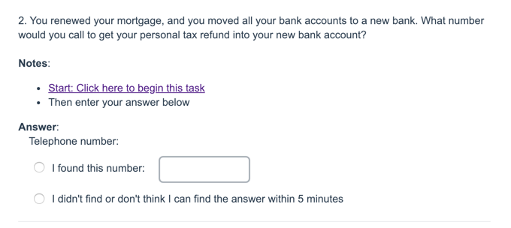
Contact Us task performance testing - comparing Baseline to Validation
Canadian small business participants
20 in Baseline (2FR) then 18 different people in Validation
Business owners with 0-5 employees from across Canada
Range of business & digital skills
1 hour test session with same tasks
10+ task scenarios to do on Canada.ca in Baseline, on prototype in validation
+ voice/chatbot use in validation
Surveygizmo link for Baseline
Surveygizmo link for Validation
Prototype
Sessions were recorded & anonymized, shared with their permission via unlisted Youtube
Notes:
Task 1 first for every participant, then pseudo-random order with form tasks spread out among phone tasks

Slide 8
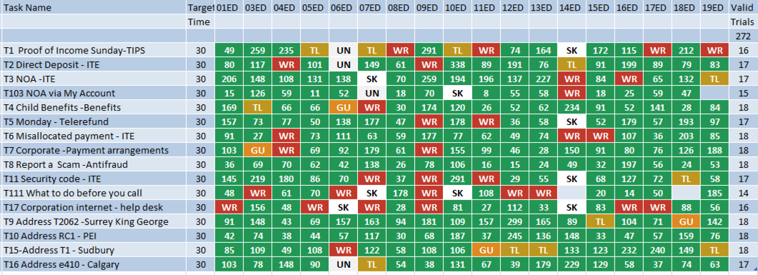
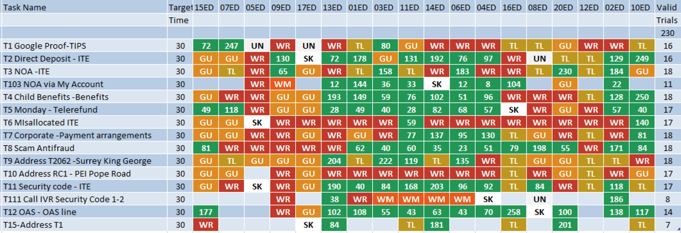
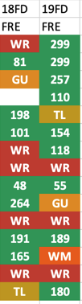
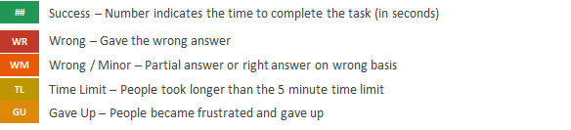
Overall task performance across 273 tests
Design was tuned to resolve issues as they appeared
Validation
Baseline
SK Skip task - insisted on My Account or on not calling
UN Did not understand task tax or business concepts

Slide 9
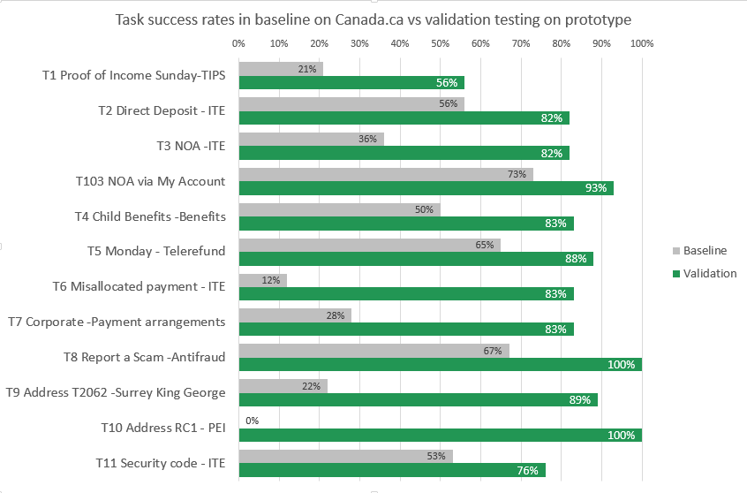
Success rates improved from 40% to 85%
Get the right number for a top call driver
Move callers to automated lines
Get the right address for RC1 form - from 0% to 100%

Slide 10
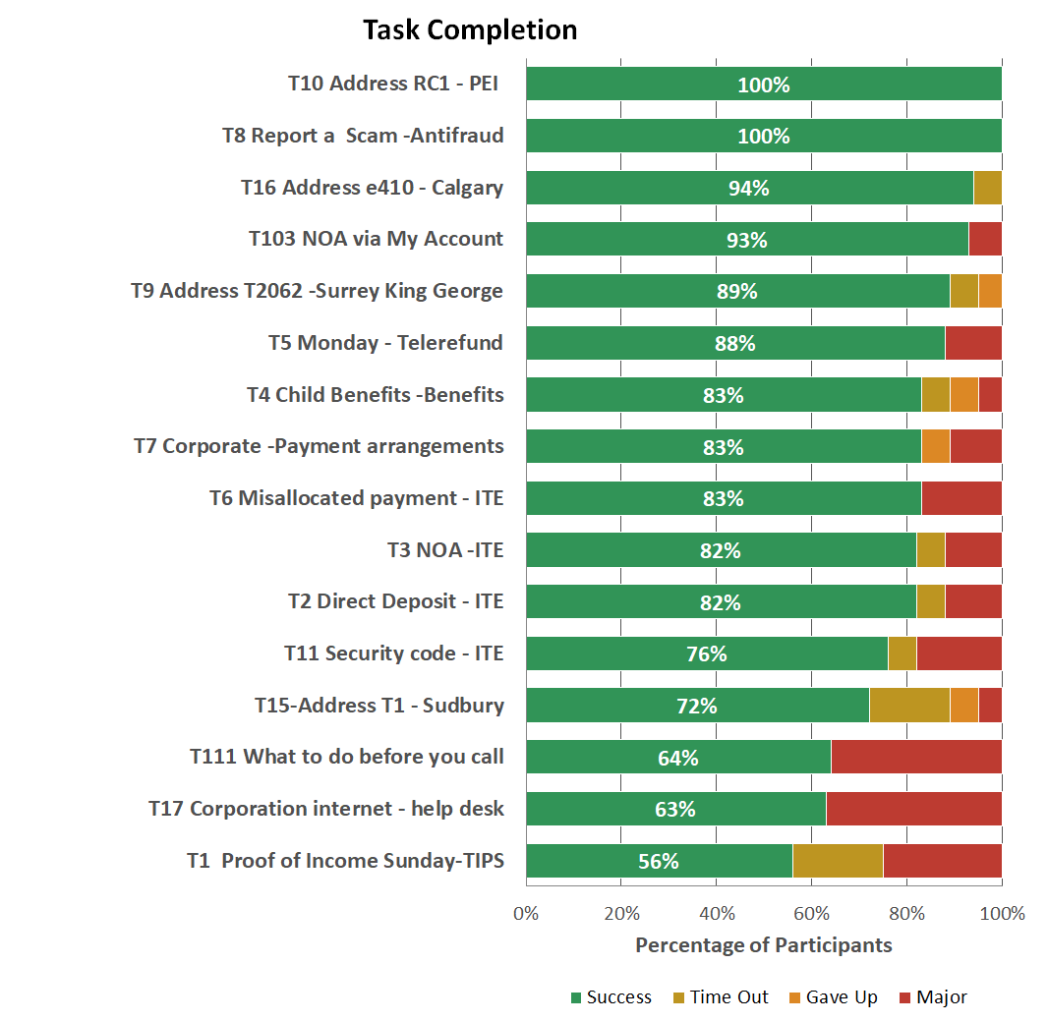
All tasks by success rate - new tasks to test new ideas
Successful test of new address finder for form with no address on it
*
Only 3/7 found this address in baseline - much improved in prototype especially with Find a mailing address button
*
Successful test of whether people notice & use new Before-you-call checklist
*
*
Test if new approach works as well for less-used phone lines - improved over time
Notes:
Task order plays a role here - T7 was last, T1 was first...

Slide 11
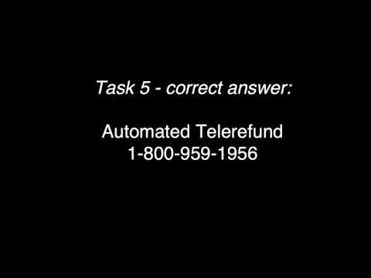
Takeaways for producing a big impact on success
Design for top contact tasks
Top call drivers get custom contact pages
Help people choose correctly from many
Clickable choices simplify & help narrow
From 40% to 85%
Group for search & preparedness
Show hours and checklists with numbers
Reduce calls - show online first
Consistent design pattern for contacts
Answers not information
Wizard to find addresses & phone numbers
Place address box at the bottom of forms
If more than 2 potential addresses (e.g by region), place the link at the bottom of the form
Quick overview video: https://youtu.be/1cEiqqaDRQ8

Slide 12
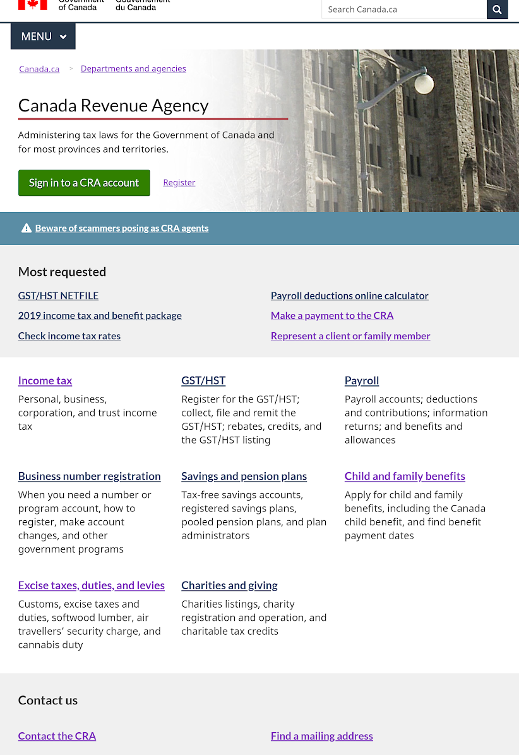
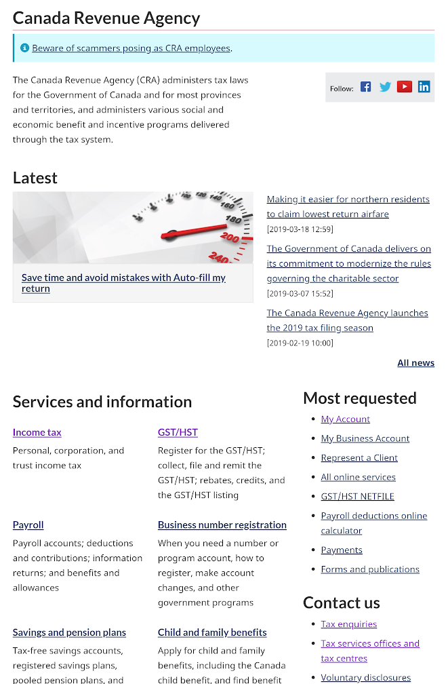
Start with the institutional profile
Super task - My Account gets 40% of clicks
Many didn’t scroll - saw Latest news - buries task content
People saw Top tasks first and used services
In baseline, many used footer instead of enquiries
People found Contact us easily
Notes:
Live: https://www.canada.ca/en/revenue-agency/corporate/contact-information.html and
Validation: https://gc-proto.github.io/cra-contactus/scenarioA/revenue-agency/corporate/contact-us.html

Slide 13
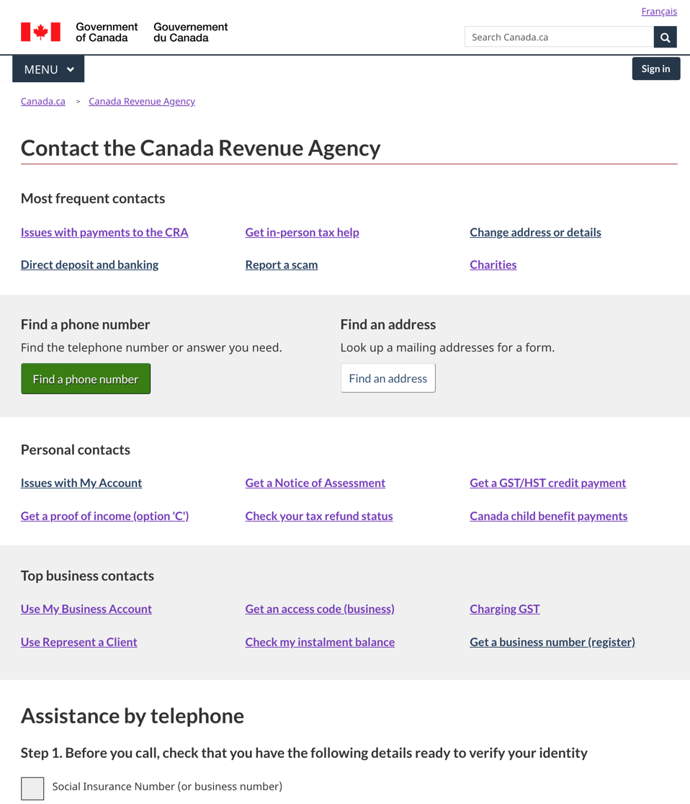
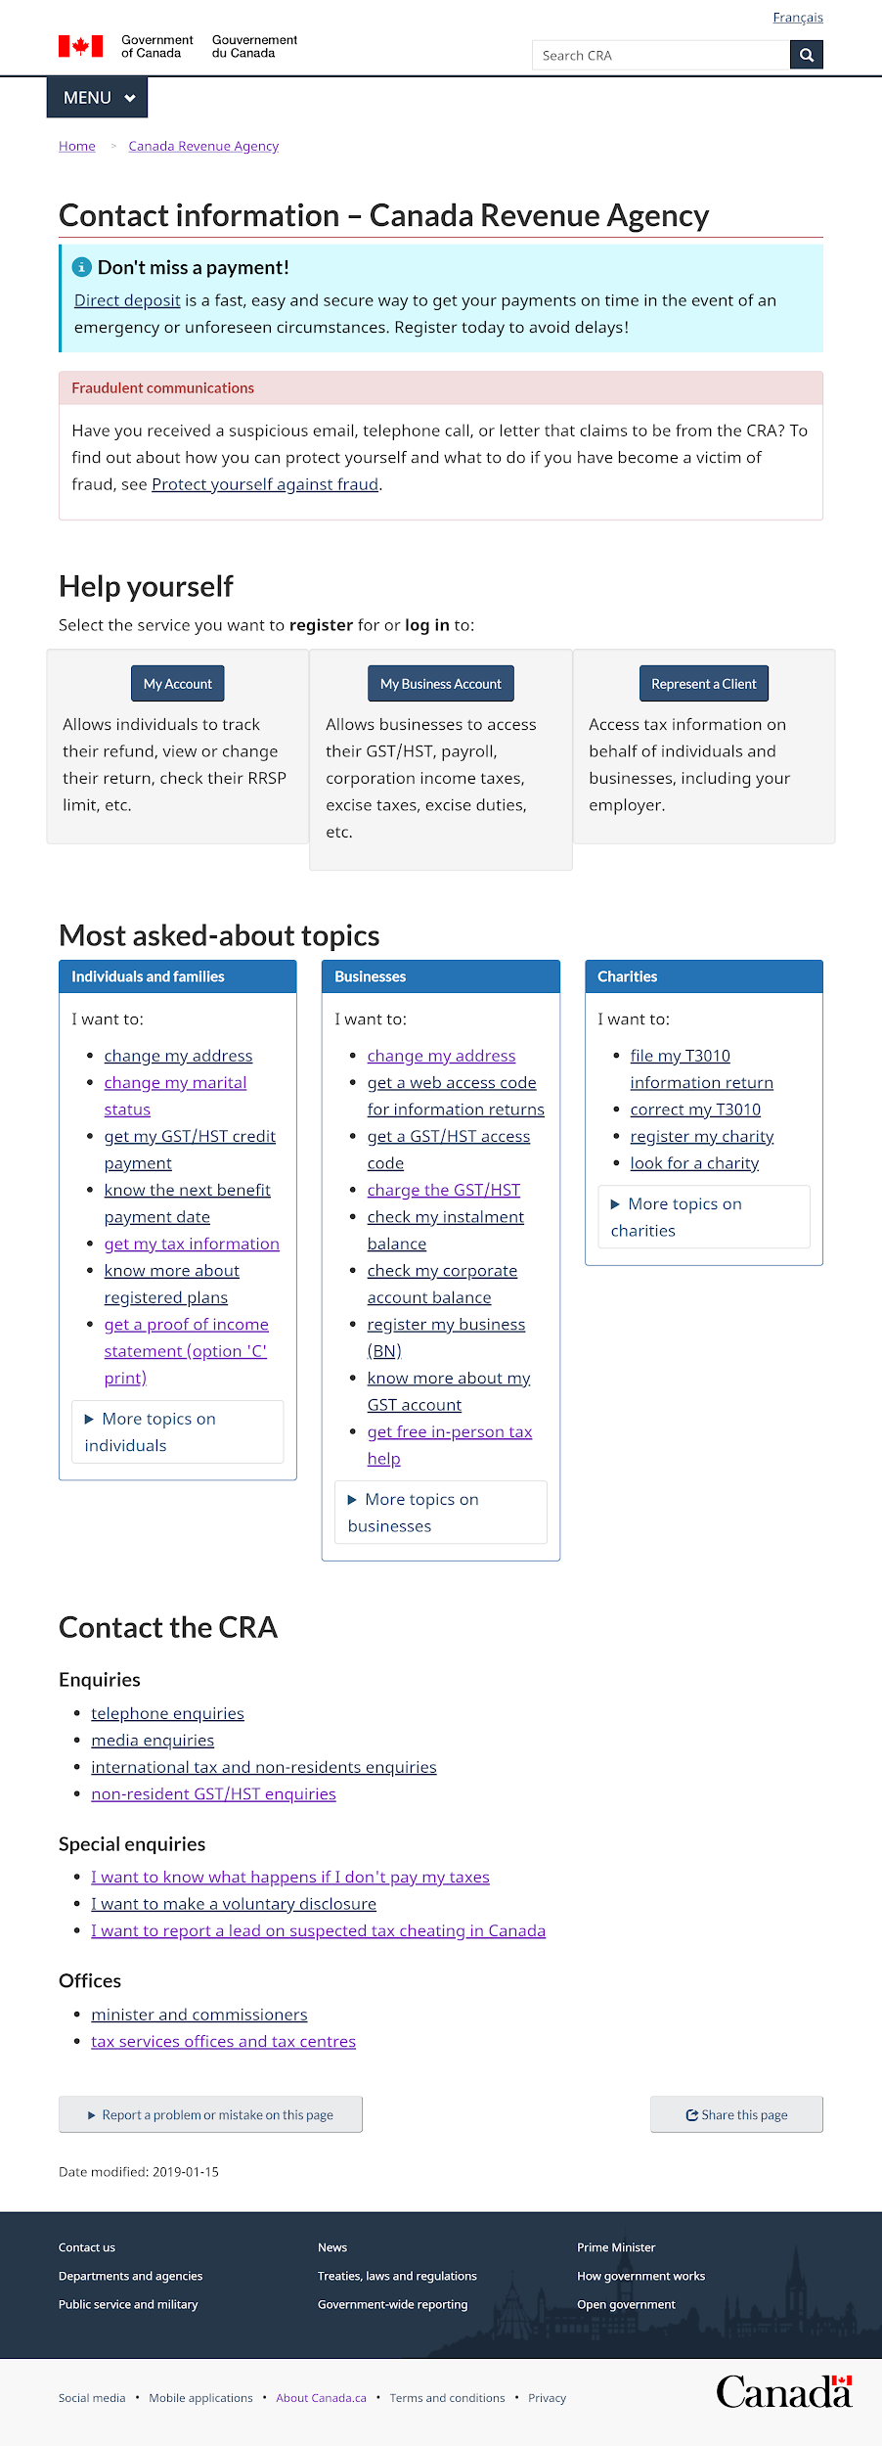
Improving by focusing on top contact tasks
“Invisible boxes” push down task content
People used top contact links, the stripes help provide grouping
Account boxes are large but rarely used (5% of clicks on page)
Contacts for accounts for top call driver replace boxes
People rarely used or found these links

Slide 14
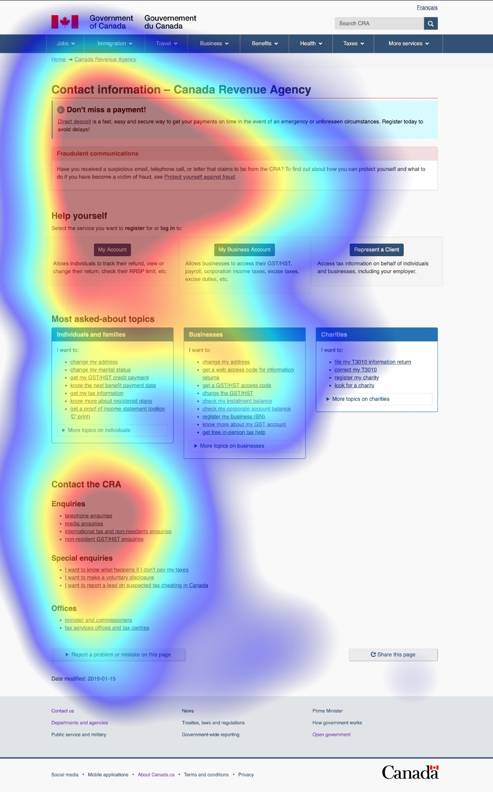
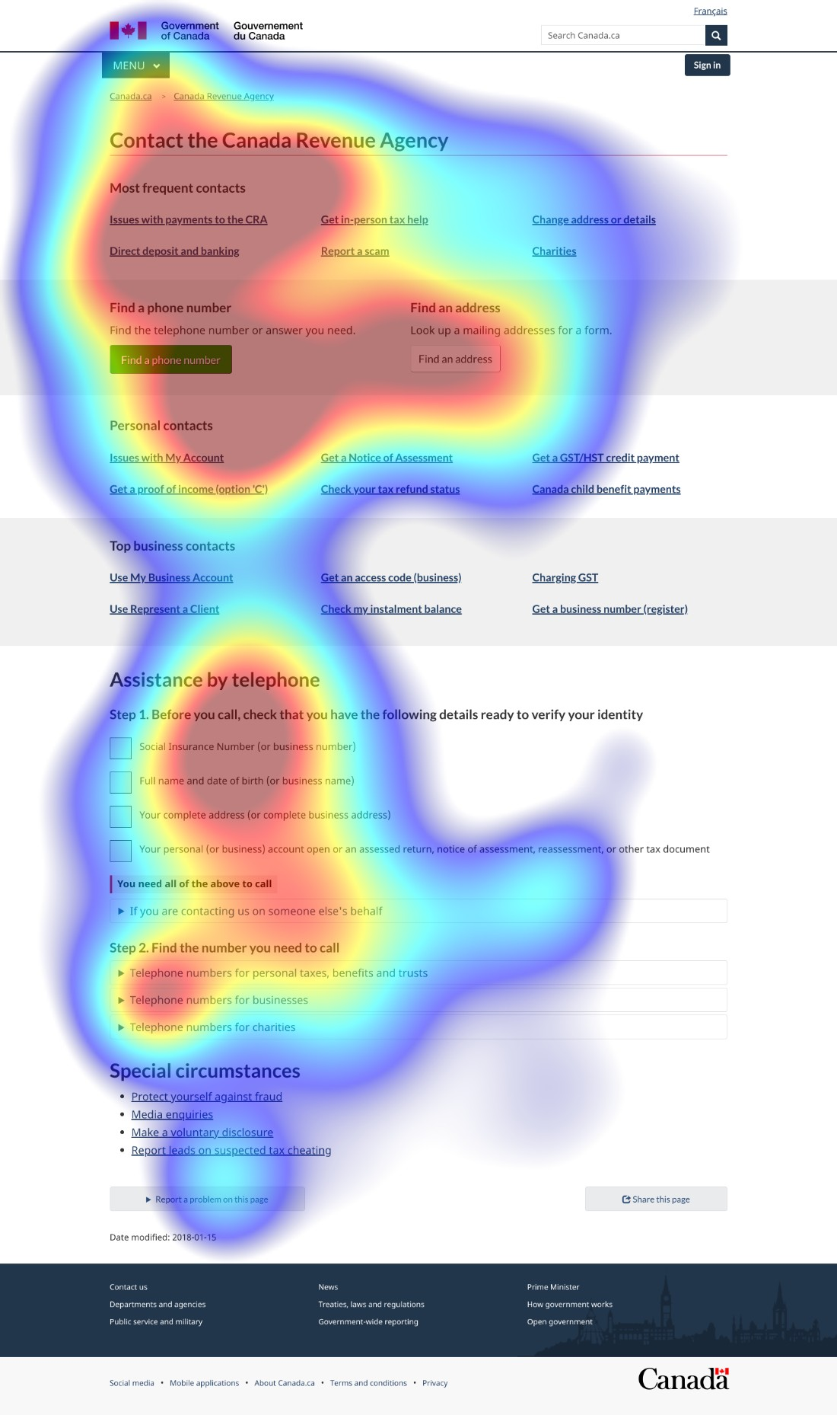
Contact page: Design for visibility of top contact tasks
This eyetracking comparison shows why more top contact links (large green boxes) were viewed and used in the prototype more than in the live contact page.
Notes:
Number of people in heatmap: 11
The target for this task was the direct deposit link highlighted in green, which only 1 person found in the baseline study, but 9 found in the new design.

Slide 15
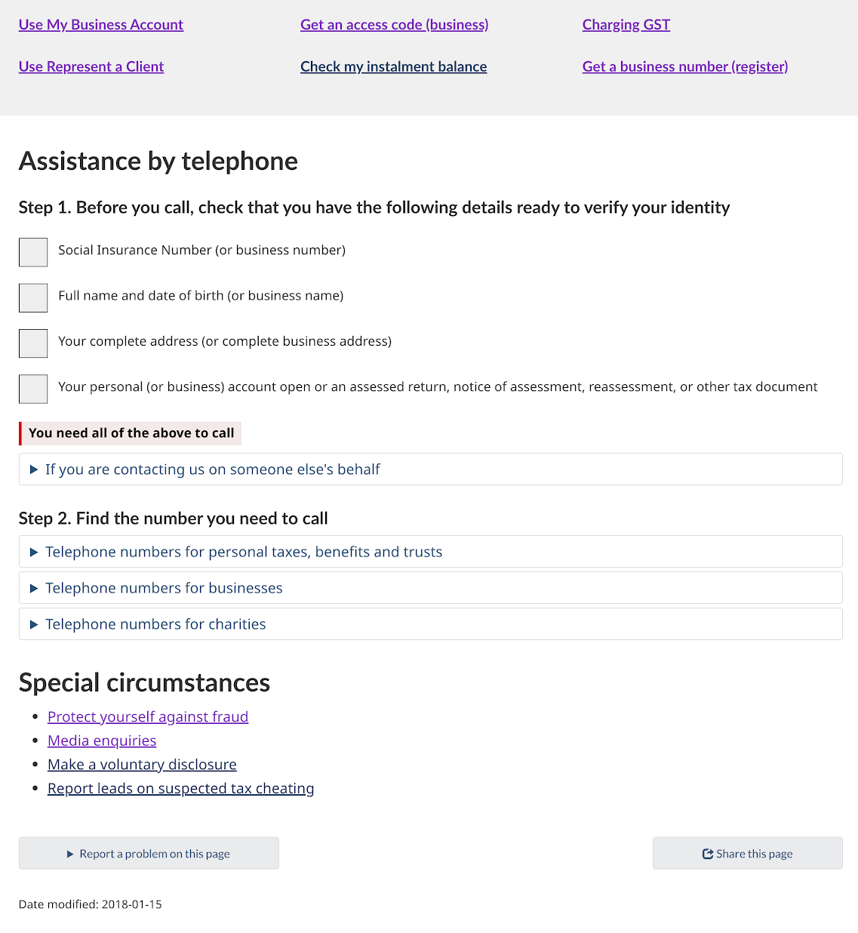
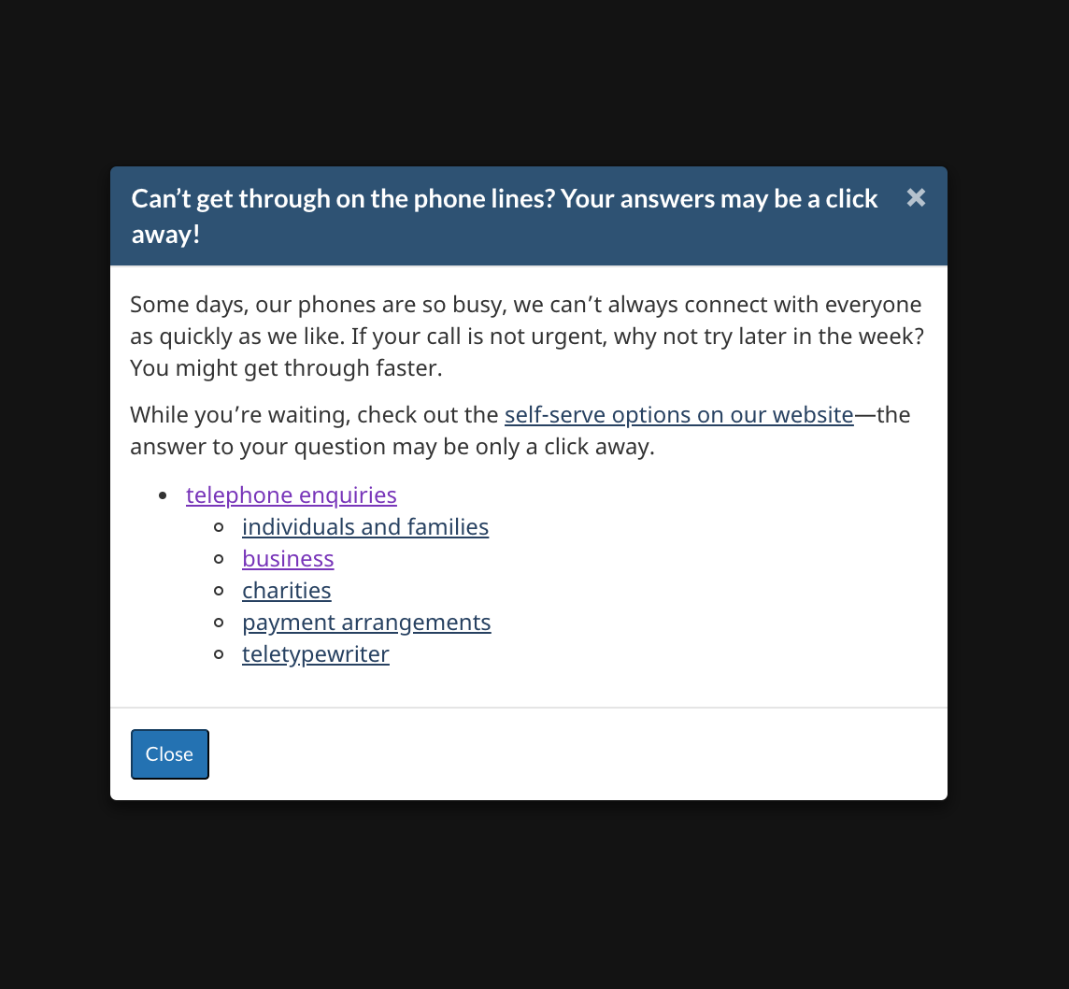
Group for search - Phone numbers on the contact page instead of separate
Progressive disclosure of numbers - help people choose not find
Numbers at bottom of page, people confused by “enquiries” - had to get through overlay, some bounced back

